Slide 1

Data analysis using Crisp-DM
By Issac Lim, Lim Jin Bin, Edric Sng Hong Kai
A GREENER COUNTRY
A BETTER WORLD

Slide 2

JIE Sustainability
Business Understanding
1
Data understanding
2
AGENDA
Data preparation
3
Visualisation
4
Conclusion
5

Slide 3
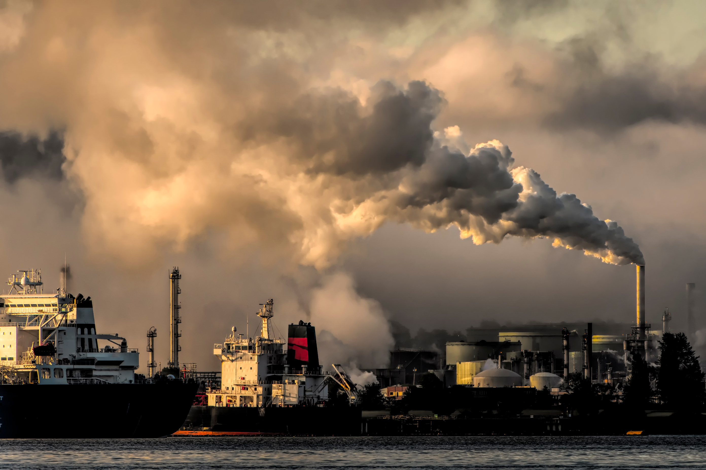
Business Understanding

Slide 4

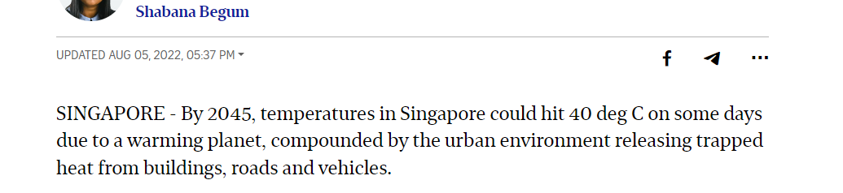
PROBLEM
01
According to the International Energy Agency, global energy and consumption has nearly tripled since the 1970s.
02

Slide 5

BUSINESS OBJECTIVES
JIE Sustainability
Analyse the current state and trends of carbon emissions in Singapore to track our progress towards Net Zero Emission by 2050
Analyze the conditions and trends in sectors with high carbon emissions in Singapore and provide recommendations for emission reduction.

Slide 6
DATA MINING GOALS
JIE Sustainability
What is the relationship between annual carbon emissions and GDP over the past few years?
Compare the per capita carbon emissions of Singapore with those of other developed countries in Asia and the global average to understand Singapore’s standings against them
Analyse the carbon emissions of various sectors in Singapore in 2022, and identify the 3 main contributing sectors
Based on the carbon emissions of these three main sectors in the past 10 years, find out what is their relative contribution towards Singapore’s yearly carbon emission and use the data obtained to make suggestions to reduce the carbon emissions.

Slide 7
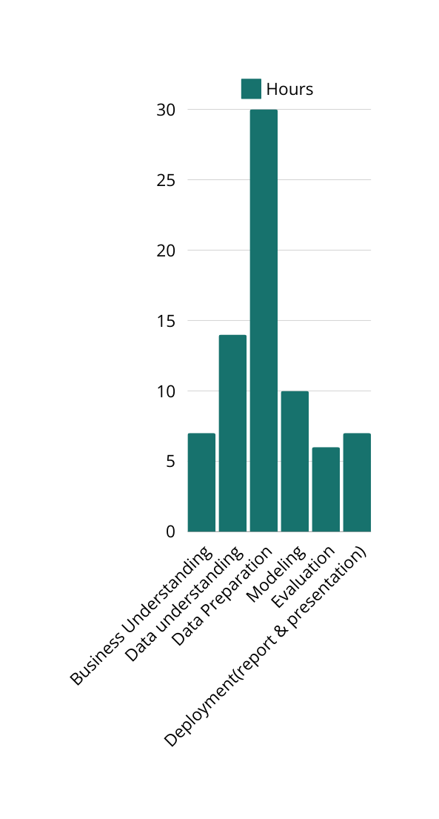
PROJECT PLAN
JIE Sustainability
JIE Sustainability
NO. | Tasks | Estimated Man hours
1 | Business Understanding | 7 hours
2 | Data understanding | 14 hours
3 | Data Preparation | 30 hours
4 | Modeling | 10 hours
5 | Evaluation | 6 hours
6 | Deployment(report & presentation) | 7 hours

Slide 8

Data Understanding

Slide 9
CONSTRAINTS
JIE Sustainability
Problems faced during data exploration
Limited data
It was hard to find some of the datasets we needed
Data accurate as of until 2022
Some countries do not have carbon emissions for certain years as they are non existent during that time.
The data were in different formats which made it hard to merge our datasets
Inconsistency

Slide 10
ASSUMPTIONS
JIE Sustainability
I assumed that emission changes are due to the policies and strategies put in place by the government
I assumed that CO2 emissions are completely split among the different sectors every year. meaning that the total CO2 emitted from all sectors is equilvalent to that of the annual emissions.
In data preparation for any null or duplicated values recorded, we will just take it as system error and we will drop all the rows directly.

Slide 11

Data Preparation

Slide 12
Platforms used for data prep
JIE Sustainability
Google Colab/python
Data cleaning
Data aggregation
Grouping the required data into datasets
merge datasets
PowerBI/Power query editor
Transform the data into the format we want
Visualise our data in charts

Slide 13

USING DATASETS
EDGAR - The Emissions Database for Global Atmospheric Research (europa.eu)
https://ourworldindata.org/population-growth (ourworldindata.org)
GDP (current US$) | Data (worldbank.org)
WEBSITES
EDGAR
Our World In Data
RENAME DATASETS
co2_emission_countries.csv:
co2_per_capita_countries.csv:
co2_per_gdp_countries.csv:
co2_sector_countries.csv:
population.csv
gdp_countries
World Bank

Slide 14
Datasets Insight
The code snippet uses pandas to load 6 different datasets into DataFrames for exploration and analysis:
co2_emission_countries.csv:
Gives information of total carbon emission for each country/sovereign state over the years.
co2_per_capita_countries.csv:
Displays the annual carbon emission per capital for each country/sovereign state over the years
co2_per_gdp_countries.csv:
Displays the annual carbon emission per gdp for each country/sovereign state over the years
co2_sector_countries.csv:
Maps the annual total carbon emission to different sector of each individual country/sovereign state over the years.
gdp_countries.csv:
Displays the annual gdp for each country/sovereign state over the years in billions
Population.csv:
Shows the population of years

Slide 15
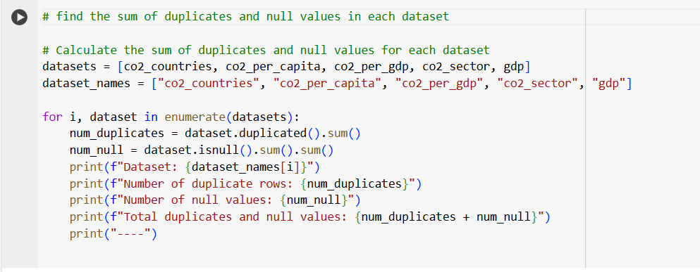
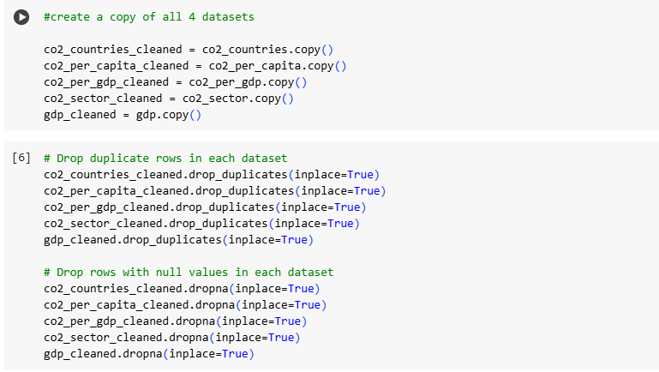
duplicates and null values
Finding the number of null/duplicated values
Dropping the null/duplicate values

Slide 16

Visualisation

Slide 17
JIE Sustainability
Dashboard 1 (Edric)
What is the relationship between annual carbon emissions and GDP over the past few years?

Slide 18
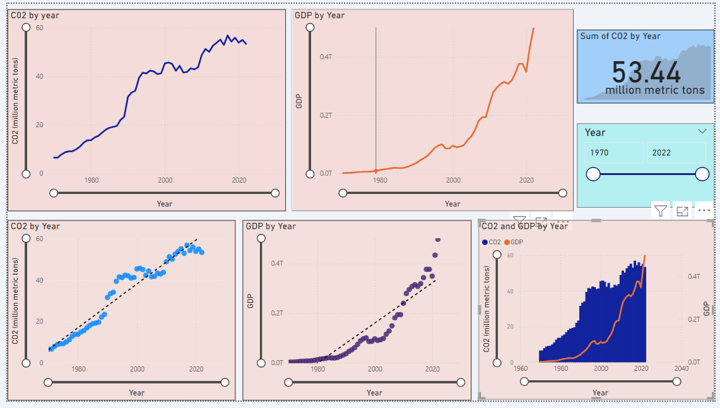

Slide 19
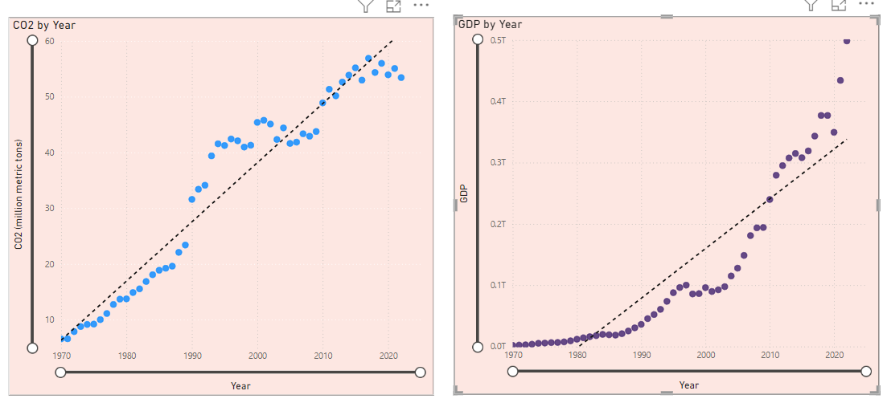
Compare Singapore's carbon emissions and GDP

Slide 20
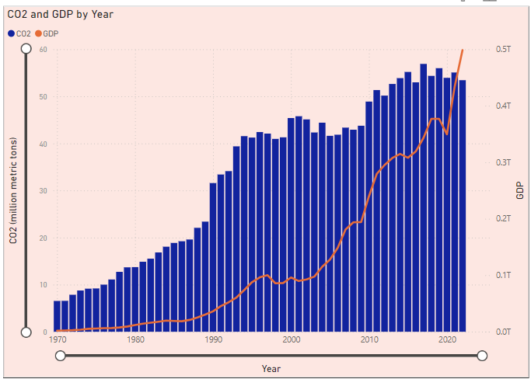
Compare Singapore's carbon emissions and GDP

Slide 21
JIE Sustainability
Dashboard 2 (Jin Bin)
Compare the per capita carbon emissions of Singapore with those of other developed countries in Asia and the global average

Slide 22
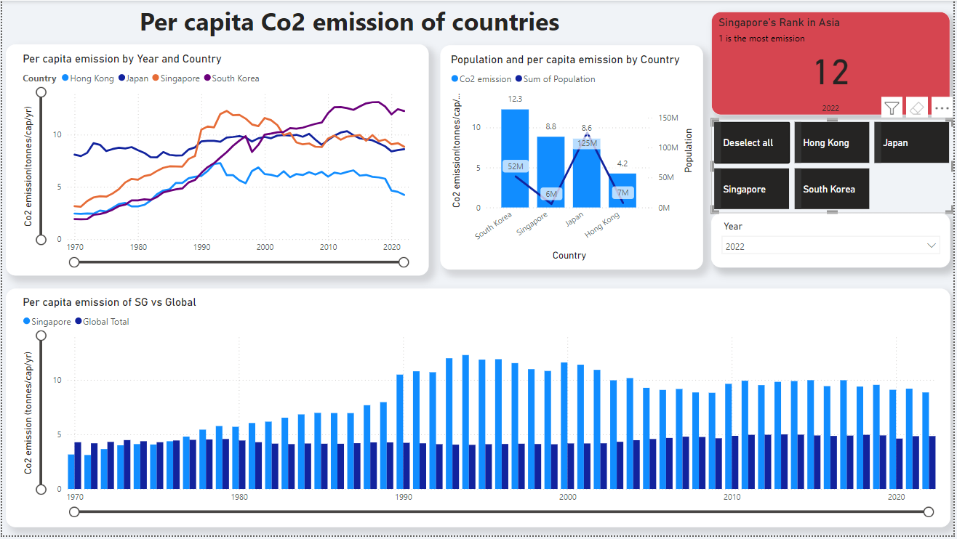

Slide 23
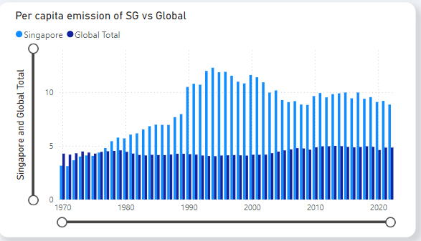
Insights and recommendations
Singapore has consistently higher per capita emissions
Note: global average is influenced by populations of all countries, including those with large population and low per capita emission

Slide 24

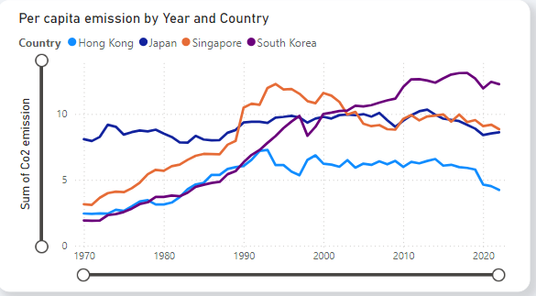



Insights and recommendations
Singapore’s emission spiked and declines after
Emission surge for South Korea
Japan’s emission is stable throughout
Hong Kong’s trend of emissions is quite stable
South Korea won’t be included in the comparison due to its high emissions

Slide 25
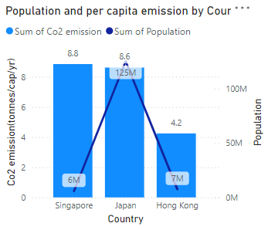
Insights and recommendations
Very minimal difference
Japan won’t be included in the comparison due to the similar emission levels

Slide 26




Recommendations from Hong Kong
Electric Vehicle (EV) incentives (can be improved)
Tax rebate up to $15,000 off the Additional registration fee (ARF)
‘1 for 1 replacement’ scheme for EVs --> $30,000
2. Singapore's Green Mark Certification (can be improved)
designed to evaluate a building's environmental impact and performance.
Currently, it only needs to be done once.
Make a mandatory 5 year energy audit

Slide 27
JIE Sustainability
Dashboard 3 (Issac)
Analyse the carbon emissions of various sectors in Singapore in 2022, and identify the 3 main contributing sectors

Slide 28
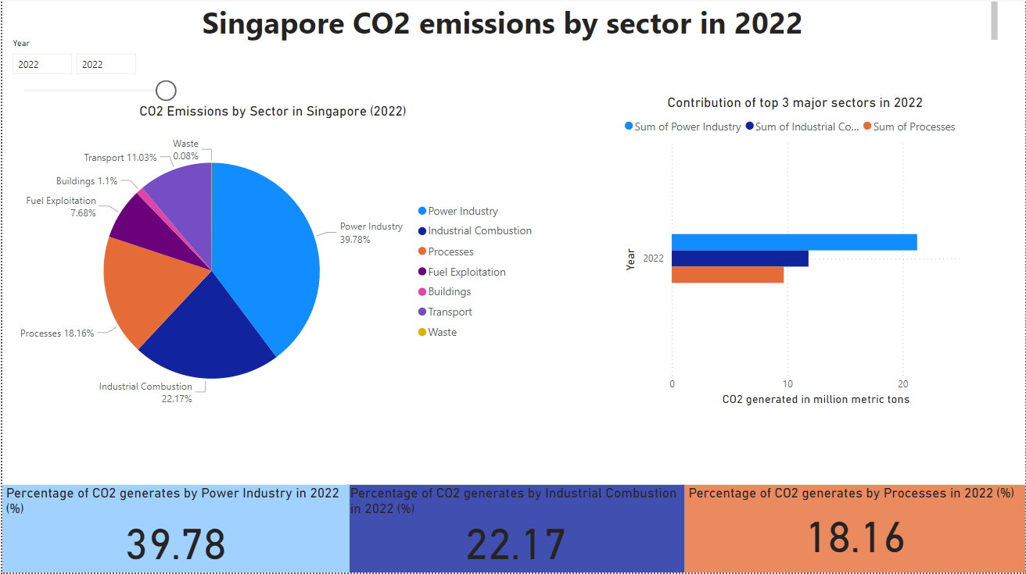

Slide 29
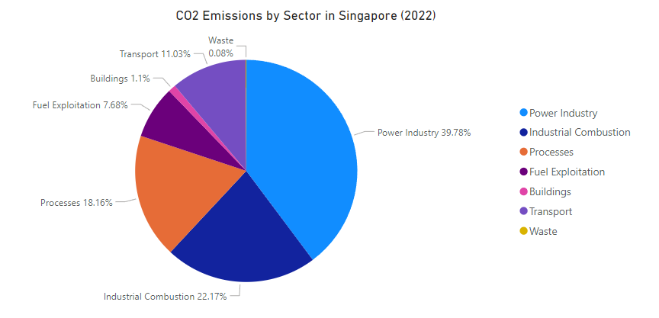
Data visualisation & insights
Singapore's carbon emissions are contributed from 7 sectors :
Power industry, Industrial combustion, Processes, Fuel exploitation, Buildings, Transport and Waste.

Slide 30
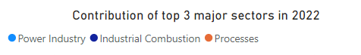
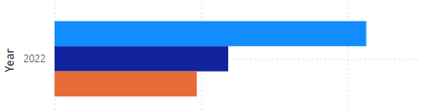
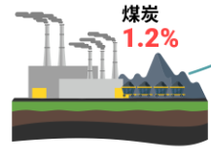


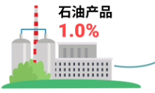
Data visualisation & insights
The 3 major sectors are
Power Industry,Processes and Industrial combustion.
Power Industry
39.78%
Industrial Combustion
22.2%
Mainly due to Singapore being an international oil storage and refining centre.
80.14%t
Processes
18.16%t

Slide 31
JIE Sustainability
Dashboard 4 (Issac)
Analyze the conditions and trends in sectors with high carbon emissions in Singapore and provide recommendations for emission reduction.

Slide 32
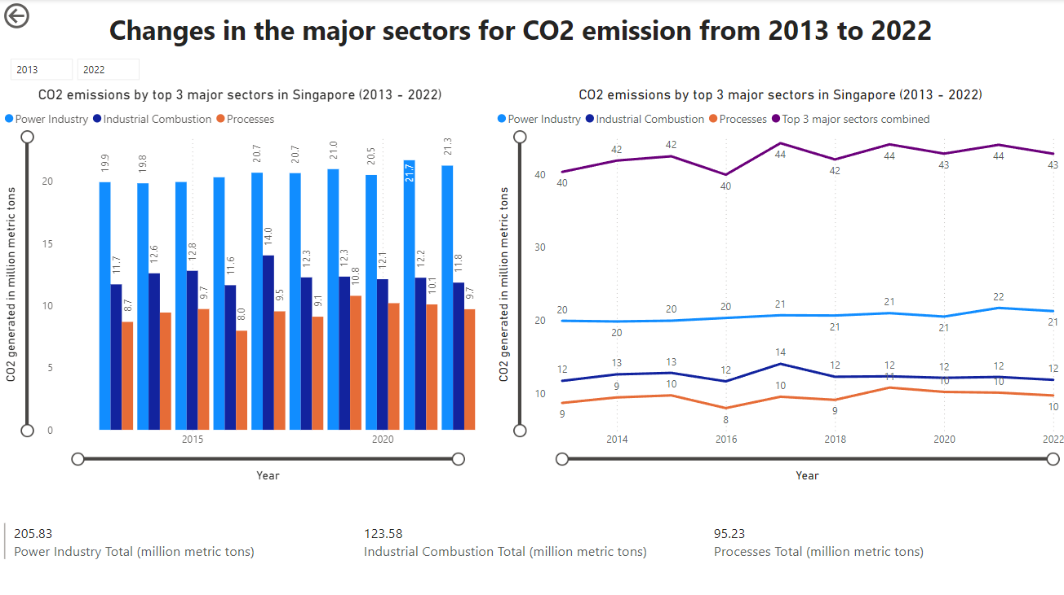

Slide 33
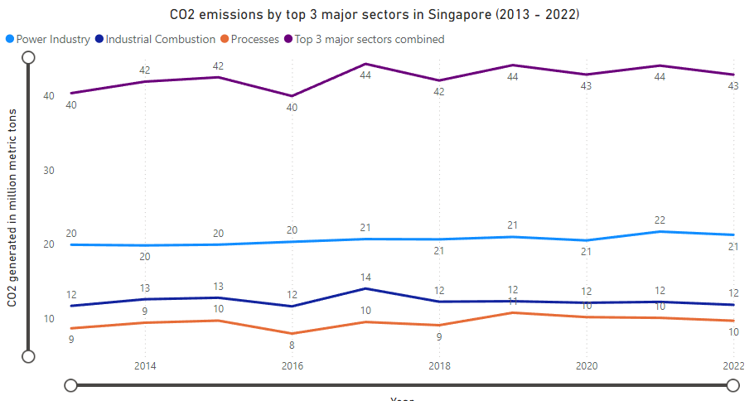

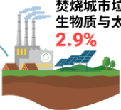
Data visualisation & insights
shown to be stable and have been at a high level
It shows that our country's industrial structure has not made any adjustments over the past 10 years. These three major sectors have always been the main pillars of Singapore's economic development.

Slide 34

JIE Sustainability
SUGGESTIONS:
JIE Sustainability
01
Impose strict restrictions of the development of enterprises with large emissions.
02
Regulating Organisational Electricity Consumption.
03
Accelerate the use of solar energy as our main renewable energy source.
JIE Sustainability

Slide 35


The insight derived from above analysis：
Provide people with a clearer understanding of the country’s carbon emissions.
Provide actionable emission reduction strategies thereby fostering our progress towards net zero emission in 2050.
Thynk Unlimited

Slide 36
Q&A
Thynk Unlimited

Slide 37
REFERENCE/DATA SOURCE LINKS
JIE Sustainability
https://climateactiontracker.org/countries/singapore/
https://www.nccs.gov.sg/
https://interactive.zaobao.com/singapore-carbon-emissions/
https://www.edpr.com/apac/en/where-do-singaporeans-stand-terms-carbon-dioxide-emissions-capita-compared-rest-world
https://ourworldindata.org/co2/country/singapore
https://www.lta.gov.sg/content/ltagov/en/industry_innovations/technologies/electric_vehicles/transitioning_to_evs.html#:~:text=From%201%20Jan%202024%20to,ARF)%2C%20capped%20at%20%2415%2C000.&text=From%201%20Jan%202024%20to%2031%20Dec%202024%2C%20VES%20Band,will%20be%20lowered%20to%20%245%2C000.
https://www.thestandard.com.hk/section-news/section/11/260790/Tax-breaks-slashed-for-electric-vehicles#:~:text=Under%20the%20%22One%2Dfor%2D,be%20lowered%20to%20HK%2458%2C500.
EDGAR - The Emissions Database for Global Atmospheric Research (europa.eu)
JIE Sustainability

Slide 38
JIE Sustainability
THANK YOU
Issac Lim
Lim Jin bin
Edric Sng Hong Kai
August 2024

